Slide 1
System Security Test Record

Slide 2
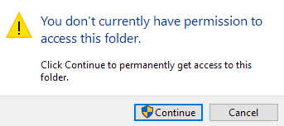
Levels of Permissions
There has been designated 3 levels of permissions based on the types of user. The levels are: Temporary, Local and Administrator.
Temporary Users can only store files in the allocated storage. For this test we designated the Temporary user as Test1. Local Users has access to Temporary storage area and can modify and move files to a certain extent. Administrators have access to all system tools relating to modifying files and setting in the system.
Having 3 levels of permissions allows easier moderation of files within the system because it limits who can edit specific files which would allow easier monitoring of unauthorized file access.

Slide 3
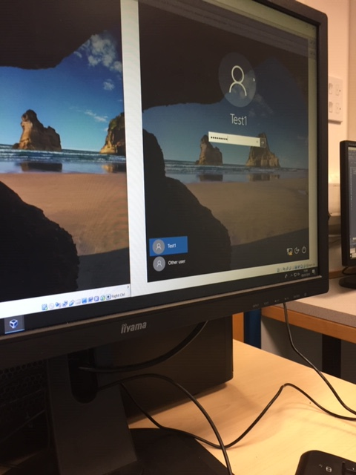
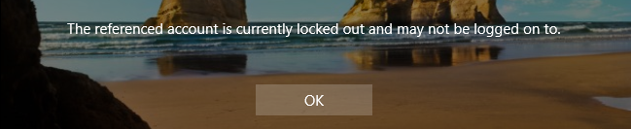
Password Security
The system requests a password on first time set up and it request a password change biweekly from that point. The password has to contain at least 8 characters and 2 numbers. If the password has been inputted incorrectly 3 time then the account will be locked against future attempts for a set of time. For this test we set the lockout time to 2 minutes.

